Slide 1
Course business
Chaucer challenge
LTEN courses for W and Sp
Take a look at the syllabus
Paper one?

Slide 2
Sir Gawain and the Green Knight
Romance—Chivalric Romance
Chrétien de Troyes
Knightly Character—Auerbach
Courtly Love
Metrical Romance
Alliterative Revival

Slide 3
Romance
Terms from Murfin and Ray
Romance is a genre
12th c. narrative form
Chrétien de Troyes
Line 1509 ff

Slide 4
Erich Auerbach on Romance
“A self-portrayal of feudal knighthood with its mores and ideals is the fundamental purpose of the courtly romance”

Slide 5
Courtly Love
Troubadors
Court of Eleanor of Aquitaine
Chrétien de Troyes
Arabic Influences
Courtly context
Poetic forms: lyric, romance, allegory

Slide 6
Some characteristics of “Courtly Love”
Elevated status of the “lady”
Terminology of feudalism
Secrecy/adultery
Love as ennobling (neoplatonism)
Love is rooted in the soul
Love is faithful
Role of sexuality

Slide 7
Form--SGGK
Metrical Form and the Alliterative Revival
Alliterative Stanza
Bob
Wheel
Tight Narrative Structure

Slide 8
SIÞEN þe sege and þe assaut watz sesed at Troye,
Þe borȝ brittened and brent to brondeȝ and askez,
Þe tulk þat þe trammes of tresoun þer wroȝt
Watz tried for his tricherie, þe trewest on erthe:
Hit watz Ennias þe athel, and his highe kynde,
Þat siþen depreced prouinces, and patrounes bicome
Welneȝe of al þe wele in þe west iles.
Fro riche Romulus to Rome ricchis hym swyþe,
With gret bobbaunce þat burȝe he biges vpon fyrst,
And neuenes hit his aune nome, as hit now hat;
Tirius to Tuskan and teldes bigynnes,
Langaberde in Lumbardie lyftes vp homes,
And fer ouer þe French flod Felix Brutus
On mony bonkkes ful brode Bretayn he settez
wyth wynne,
Where werre and wrake and wonder
Bi syþez hatz wont þerinne,
And oft boþe blysse and blunder
Ful skete hatz skyfted synne.

Slide 9
Narrative Structure
Parallels
Numerical Patterns

Slide 10
Cotton Nero A.x.
The Pearl Poet
Patience
Cleanness
Pearl

Slide 11
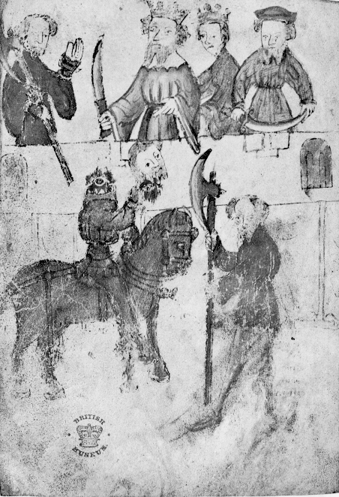

Slide 12
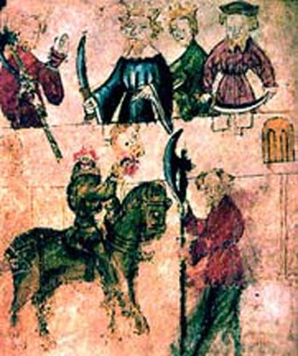

Slide 13
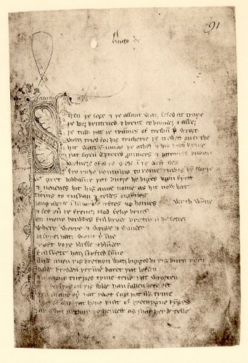

Slide 14
The Christian and the Courtly

Slide 15
Fit One
Camelot and Troy
Opening—is everything what it seems?
The Christmas Feast
A kissing game (Line 17)

Slide 16
Camelot and Troy
Noble history (Aeneas, Brutus)
Troubled history
The demise of Camelot

Slide 17
The Christmas Feast
There’s something about Arthur
Line 85
But Arthur would not eat until all were served
The Green Knight’s Challenge
Line 224 ff

Slide 18
The Green Knight
“Aghlich Mayster”
Trans. line 136 “unknown rider” or “a fearful form”

Slide 19
Fit Two--Overview
The Seasons
The Pentangle Shield
Wilderness vs. Civilization

Slide 20
Pentangle Shield (l. 618 ff)
God’s armor : Ephesians 6
Interlocking virtues
The Number 5
Solomon
Connected to Girdle

Slide 21
Fit II
Wilderness and Civilization
Line 691 ff

Slide 22
Fit II Some Parallelisms
Another Court
The Two Ladies (Line 950 ff.)
Another Christmas Game (l. 1105 ff.)

Slide 23
Fit III--Overview
The Two Hunts
The Agreement with Bercilak
Questioning the text: Why all these detailed hunting scenes?

Slide 24
The Two Hunts
Hunting and Seduction juxtaposed
Gawain’s Identity Challenged (ex. l. 1290 ff. ; l. 1481ff)
The Girdle (l. 1829)

Slide 25
Gawain’s Identity Challenged
Are you Gawain?
Hunted and torn apart
Feminized

Slide 26
Fit III
The Agreement with Bercilak
Line 1380 ff.

Slide 27
Fit IV Overview
The challenge at the Green Chapel
The importance of the religious calendar

Slide 28
Fit IV
The Green Chapel l. 2160
2 attempts
L. 2265
L. 2296
Gawain’s Failure
Knick l. 2311
Feast of the Circumcision
Deut. 10:16: Circumcize therefore the foreskins of your heart and be no more stiff-necked

Slide 29
Fit IV
Bercilak’s revelations l. 2338
Gawain’s confessions
Earlier confession. L. 1880
Confession to GK L. 2385

Slide 30
Fit IV
The role of women
Gawain’s tirade L. 2414
Morgan L. 2444

Slide 31
Fit IV
The Return to Camelot
The Garter’s meaning
Dualism in Camelot
Gawain has been tested:
Strength/Frailty; Honor/Cowardice
Fidelity/Trickery; Masc./Feminine

Slide 32
SGGK—Summary points
Complex structure
Romance: genre concerned with Knightly Identity
Honor
Masculinity
Sexuality

Slide 33
SGGK—Summary points
Poem explores questions of flaws in knightly
character/chivalry
Strong Christian component in the text

