Slide 1
English Drama
Medieval Drama
  Cycle plays/Mystery plays/Corpus Christi plays
  Morality plays

Slide 2
English Drama
Sixteenth-Century Dramatic Forms
The Professional Stage (A-49) A-80 in 8th ed

Slide 3
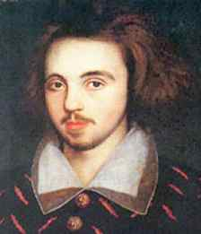
Christopher Marlowe

Slide 4
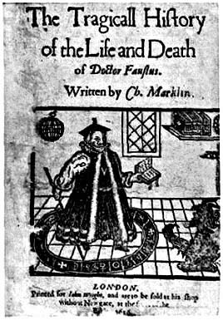
Dr. Faustus
Christopher Marlowe
The Overreacher
Marlowe’s Mighty Line
  Blank verse= unrhymed iambic pentameter

Slide 5

The Faustus Theme
Set in Wittenberg
Historie u. Geschichte Dr Johannis Faustus
Goethe
Modern Adaptations….

Slide 6
Dr. Faustus
Parodic Structure
Where else have we seen parodic inversion?

Slide 7
Dr. Faustus
Prologue—Icarus
  Prologue, line 15 ff.
  Overreacher
Foreshadowing of Faustus story

Slide 8
Act I
Faustus not content with his achievements
  Lines 10-11; 20-24
  Drawn to black magic Line 49 ff

Slide 9
Dr. Faustus
Faustus’ desires and expectations—turning things upside-down
  Divinity should be highest Act I, line 37 ff
  It becomes lowest Line 106 ff
Good Angel/Bad Angel—form of allegory
Line I.1.70 ff
Medieval influence 7 Deadly Sins Sc. 5.278

Slide 10
Scene 1
Faustus dreams of power
  Colonizing the demon/spirit world Lines78-97
  Lines 119 ff

Slide 11
Scene 3
Faustus conjures
  Anti-Catholic (line 25)
    Further example: Scene 7 (Pope)
  He is curious
  Mephastophilis tells him of the nature of hell:
    Line 76 ff

Slide 12
Scene 3
Faustus expects great power for his bargain
Lines 102 ff.

Slide 13
Faustus
What is the nature of hell?
What does he get—is he already there?
See Scene 5, line 115 ff; line 135

Slide 14
Can Faustus be saved?
Scene 5, line 194 ff. He believes he cannot repent

Slide 15
Comic Scenes
Parodic
Carnival
  What is the purpose of carnival?
    “safety valve”?
    Stressing an essential humanity?
Mixture of poetry and prose

Slide 16
Parodic pairings/Downward Spiral
Scenes 3 and 4 (Faustus conjures/Wagner conjures)
Scenes 5 and 6 (Faustus pledges/Robin and Rafe conjure)
Scenes 7 and 8 (F tricks Pope/ Robin and Rafe call Mephastophilis)
Scenes 9 and 10 (Faustus is in both scenes!)

Slide 17
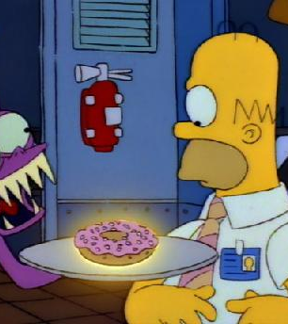
Parodic Pairing
Some claim this is a later interpolation
But let’s compare to Simpson’s parody
  It’s ridiculous to sell your soul for a donut, but what does Faustus really get for his bargain?
  Scene 4, line 8—does Faustus really get more than these low characters?

Slide 18
Faustus and Tragedy
Tragedy
Tragic Flaws
Christian or Subversive Tragedy?

Slide 19
The Old Man
Who is he?
Can we relate him to the Pardoner’s Tale?

Slide 20
The two versions of Faustus
Page 1164-65 (9th ed.)
Page 1056-7 (8th ed.)

