Slide 1
Cotton Nero A.x.
The Pearl Poet
Patience
Cleanness
Pearl

Slide 2
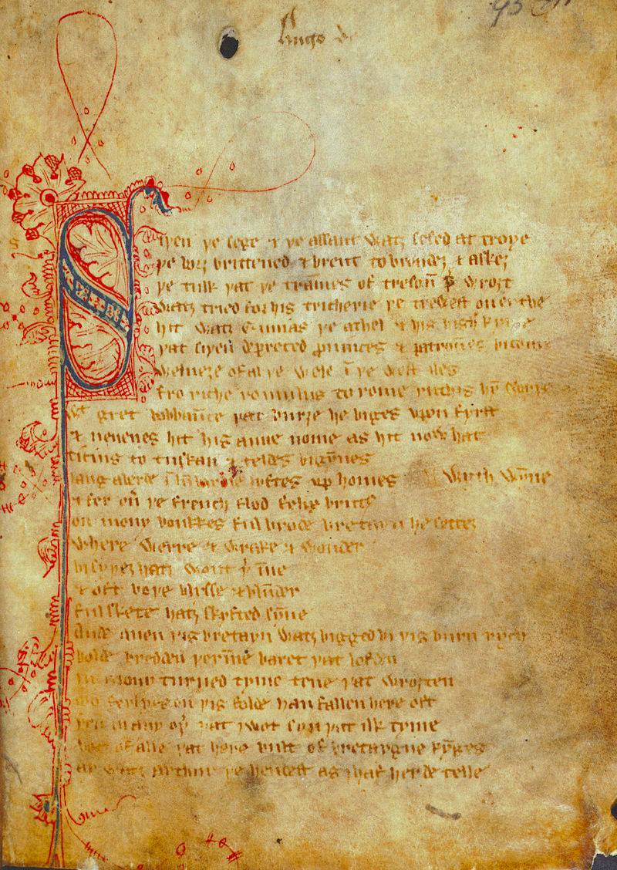

Slide 3
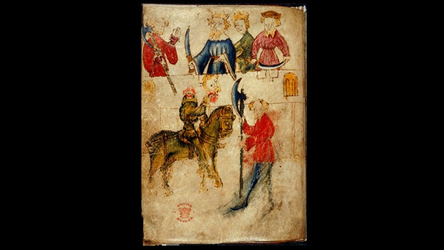

Slide 4
Fit III--Overview
The Two Hunts
The Agreement with Bercilak
Questioning the text: Why all these detailed hunting scenes? (l. 1330 ff).

Slide 5
The Two Hunts
Hunting and Seduction juxtaposed
The deer hunt (l. 1137 ff)
Gawain “hunted” (l. 1182 ff)
Gawain’s Identity Challenged (ex. l. 1290 ff. ; l. 1481ff; ll. 1514 ff)
The Girdle (l. 1829)

Slide 6
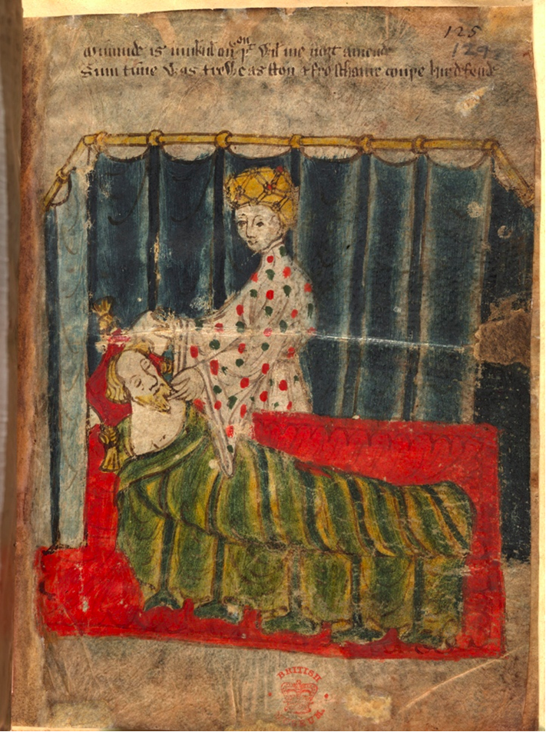

Slide 7
Gawain’s Identity Challenged
Are you Gawain?
Hunted and torn apart (l. 1920-21)
Feminized
What if Gawain had accepted the wife’s offer: L. 1237?
“Ȝe ar welcum to my cors”

Slide 8
Fit III
The Agreement with Bercilak
Line 1380 ff.

Slide 9
Fit IV Overview
The challenge at the Green Chapel
The importance of the religious calendar

Slide 10
Fit IV
The Green Chapel l. 2160
2 attempts
L. 2265
L. 2296
Gawain’s Failure
Knick l. 2311
Feast of the Circumcision
Deut. 10:16: Circumcise therefore the foreskins of your heart and be no more stiff-necked

Slide 11
Fit IV
Bercilak’s revelations l. 2338
Gawain’s confessions
Earlier confession. L. 1880
“fully and frankly he spoke of his sins”
Confession to GK L. 2385

Slide 12
Fit IV
The role of women
Gawain’s tirade L. 2411
Morgan L. 2444

Slide 13
Fit IV
The Return to Camelot
The Garter’s meaning
Dualism in Camelot
Gawain has been tested:
Strength/Frailty; Honor/Cowardice
Fidelity/Trickery; Masc./Feminine

Slide 15
SGGK—Summary points
Complex structure
Romance: genre concerned with Knightly Identity
Honor
Masculinity
Sexuality

Slide 16
SGGK—Summary points
Poem explores questions of flaws in knightly
character/chivalry
Strong Christian component in the text

