Slide 1
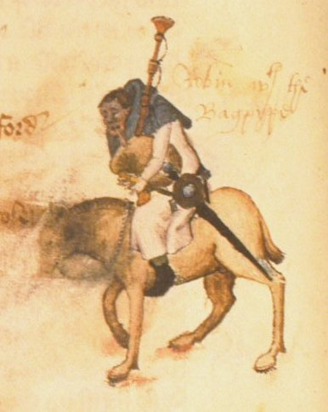
Chaucer Lecture 2

Slide 2
The Miller

Slide 3
The Miller’s Tale
Follows the Knight’s Tale
KT is a romance in high style
Classical Allusion/Fate

Slide 4
“Quiting”
The Miller “quites” the Knight
Absolon “quites” Nicholas
Estates Satire
Chaucer’s “disclaimer” (GP, l. 745 ff)
Peasant’s Rebellion 1381
Whan Adam delved and Eve span,
Who was then the gentleman?

Slide 5
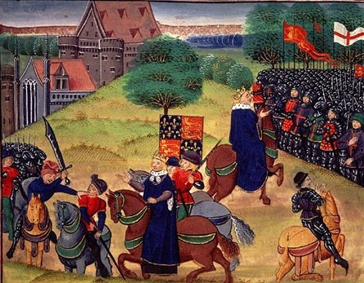
1381 Rebellion
Notes:
the Kentish men, under Wat Tyler (q.v.), entered London, where they massacred some Flemish merchants and razed the palace of the king’s uncle, the unpopular John of Gaunt, Duke of Lancaster. The government was compelled to negotiate. On the 14th Richard met the men of Essex outside London at Mile End, where he promised cheap land, free trade, and the abolition of serfdom and forced labour. During the king’s absence, the Kentish rebels in the city forced the surrender of the Tower of London; the chancellor, Archbishop Simon of Sudbury, and the treasurer, Sir Robert Hales, both of whom were held responsible for the poll tax, were beheaded. https://www.britannica.com/event/Peasants-Revolt

Slide 6
Genre vs. Genre
Romance (Knight’s Tale)
Fabliau (Miller’s Tale)

Slide 7
Cast of Characters
A. Carpenter l. 80 ff
B. “hende” Nicholas l. 91 ff
C. Alison l. 112 ff
D. Absolon l. 204 ff

Slide 8
Nicolas and Alisoun. 163 ff
Parody of Courtly Love and the Knight’s Tale

Slide 9
The Plot with the Tubs
Alison’s trick line 615 ff.
Nicholas, Absolon and the coming of the flood, 690 ff.

Slide 10
Absolon at the window
Woos Alison with “courtly” language l. 590 ff
Comedy emphasized through meter—line 639

Slide 11
How does this tale “quit” the KT?
Emily and Alison
Line 632 “Teehee” vs.
Emily’s plea for Virginity in the Knight’s Tale

Slide 12
Quitting the KT
Treatment of courtliness/courtly love
Treatment of chivalry—the tub plot

