Slide 1
The Faustus Theme
Set in Wittenberg
Historie u. Geschichte Dr Johannis Faustus
Goethe
Modern Adaptations….

Slide 2
English Drama
Medieval Drama
Cycle plays/Mystery plays/Corpus Christi plays
Morality plays

Slide 3
English Drama
Sixteenth-Century Dramatic Forms
The Professional Stage (A 51)
Notes:
The Faustus company had a hell mouth, a sittie of Rome…I dragon in fostes, a special devil, a lion, 2 lion heads, a neptune fork and garlands….

Slide 4
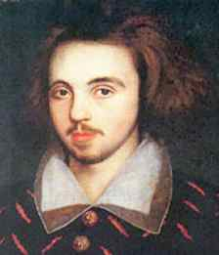
Christopher Marlowe

Slide 5
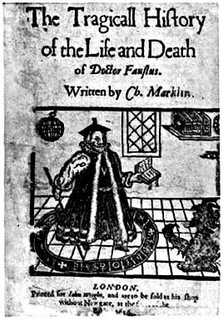
Dr. Faustus
Christopher Marlowe
The Overreacher
Marlowe’s Mighty Line
Blank verse= unrhymed iambic pentameter

Slide 6
Dr. Faustus
Parodic Structure
Where else have we seen parodic inversion?

Slide 7
Dr. Faustus
Prologue—Icarus
Prologue, line 15 ff.
Overreacher
Foreshadowing of Faustus story

Slide 8
Scene 1
Faustus not content with his achievements
Lines 10-11; 20-24
Drawn to black magic: line 49 ff

Slide 9
Dr. Faustus
Faustus’ desires and expectations—turning things upside-down
Divinity should be highest Scene I, line 37 ff
It becomes lowest Line 106 ff

Slide 10
Scene 1
Faustus dreams of power
Colonizing the demon/spirit world Lines78-97
Lines 119 ff

Slide 11
Scene 3
Faustus conjures
Anti-Catholic (line 25; p, 687)
Further example: Scene 7 (Pope)
He is curious
Mephastophilis tells him of the nature of hell:
Line 3.75 ff (page 688)

Slide 12
Scene 3
Faustus expects great power for his bargain
Lines 3.102 ff. (pp. 688-9)

Slide 13
Faustus
What is the nature of hell?
What does he get—is he already there?
See Scene 5, line 115 ff; line 135 (p. 693;p. 694)

Slide 14
Can Faustus be saved?
Scene 5, line 194 ff. He believes he cannot repent (p. 695)

Slide 15
Comic Scenes
Parodic
Carnival
What is the purpose of carnival?
“safety valve”?
Stressing an essential humanity?
Mixture of poetry and prose

Slide 16
Parodic pairings/Downward Spiral
Scenes 3 and 4 (Faustus conjures/Wagner conjures)
Scenes 5 and 6 (Faustus pledges/Robin and Rafe conjure)
Scenes 7 and 8 (F tricks Pope/ Robin and Rafe call Mephastophilis)
Scenes 9 and 10 (Faustus is in both scenes!)

Slide 17
Parodic Pairing
Some claim comic scenes are a later interpolation
But let’s compare to Simpson’s parody
It’s ridiculous to sell your soul for a donut, but what does Faustus really get for his bargain?
Scene 4, line 8 (p. 689) —does Faustus really get more than these low characters?

Slide 18
Faustus and Tragedy
Tragedy
Aristotle: “Imitation of an action that is serious and also, complete in itself”
Arouses pity and fear
Tragic hero who often falls due to a fatal flaw

Slide 19
Faustus and Tragedy
Tragic Flaws
Christian or Subversive Tragedy?

Slide 20
Faustus in Five Acts?
Act I: The Decision (Prologue and Sc. 1-4)
Act II: The Contract (Scenes 5-6)
Act III: The Challenge to Religion and Power (Scenes 7-8)
Act IV: The Disintegration of Power (Sc.9-11)
Act V: The Reckoning (Sc. 12-13)

Slide 21
The Old Man (Sc. 12)
Who is he?
Can we relate him to the Pardoner’s Tale?

Slide 22
Medieval elements in the play
Good Angel/Bad Angel—form of allegory
Scene 5.15 ff (page 691)
Medieval influence 7 Deadly Sins Sc. 5.274ff (p. 697)

Slide 23
The two versions of Faustus
Pp. 716-7

